Slide 1
Welcome to the Carlton Academy

Slide 2
Tutor Team
Ms Eglin
Mr Hope
Ms Rana
Mr Middleton
Mr Harris
Ms Dyer-Ince
Ms Savage
Miss Mason
Post 16 Team
Ms Jennings - Head of Post 16
Mr Sturrock - Deputy Head of Post 16
Mr Melton – Deputy Head teacher
Mr Cook– Post 16 Administrator
You can find staff in the Sixth Form office or email any issues, questions or concerns.
We are here to support you in fulfilling your potential, being successful and resolve any issues that may occur.

Slide 3
Life as a Sixth Form student
We are there to provide support & guidance on your Post 16 journey…

Slide 4
The school day
8.45 – Period 1
9.45 – Period 2
10.45 – Tutor time
11.05 – Break
11.20 – Period 3
12.20 – Lunch
13.05 – Period 4
14.05 – Period 5
15.10 – Period 6
Sixth Form students are expected to be in school every day at 8.45 & use non-contact time effectively to be successful in both curriculum and enrichment activities.

Slide 5
Post 16 Tutor Time Schedule
Monday | Tuesday | Wednesday | Thursday | Friday
Registers taken
Post 16 Notices/ Question of the week | PSHE | PSHE | Y12 Assembly | Quiz
Tutors should monitor attendance each day and log intervention.
Pastoral and careers appointments can be booked through Mr Cook. If you require any support with your subjects please book an appointment with Ms Jennings or Mr Sturrock.
Use Tutor Time effectively and be there on time every day

Slide 6
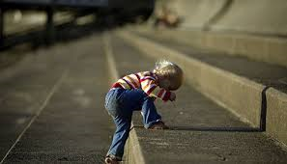
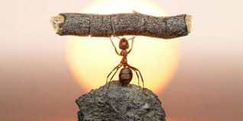
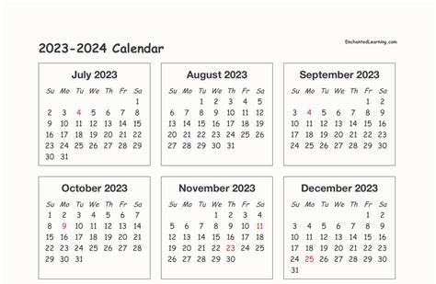
What we expect from a Sixth Form Student
What we expect from our Sixth Form students
Notes:
Determination
Work together as a group in harmony
Perseverance
Attendance and punctuality
Questioning
resilience
Dream big – Samsung advert

Slide 7
Qualities of a good student at Carlton Academy Sixth Form?
Self-motivated
Independent
Driven
Works on their own initiative
Reads around the subject
Enjoys learning
Asks questions and seeks answers
Learns from their mistakes
Organises their time effectively
Enthusiasm
Perseverance
Collaboration
How many of these do you currently have?
Which qualities could you work on?
Notes:
Spiderdiagram as a form before revealing ideas on the slide.

Slide 8
Life as a Sixth Form student
Subject Choices
Most will select 3 subjects at A level.
Some will select 4 subjects.
1 hour of enrichment/super curricular.
EPQ/Further Maths.
Notes:
Discuss change of course rule

Slide 9
These are designed to set you apart from other students when applying for University courses, Apprenticeships & job roles.
Buddy reading
Mentoring
Subject ambassador
EPQ
Lesson support
Duke of Edinburgh
Stellar Programme

Slide 10
Sixth Form Role Models
Head Boy & Head Girl
Sixth Form Committee
Student voice
Charity events
Social events & prom

Slide 11
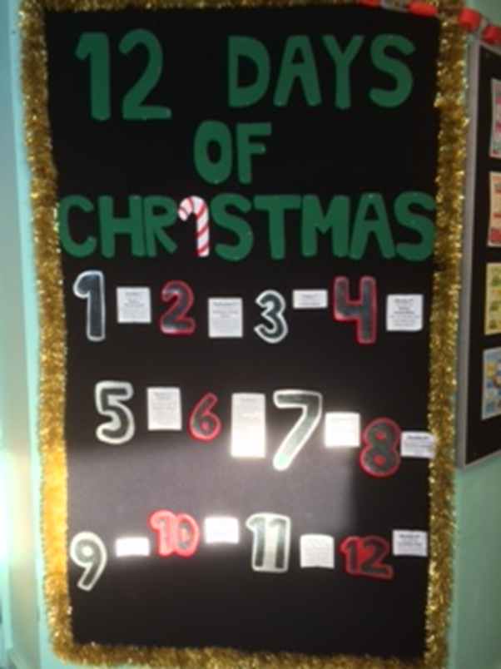
Student Committee Events

Slide 12
Life as a Sixth Form student
What we expect from our Sixth Form students
Non-contact lessons spent effectively in the Study Centre.
Allocate your study periods & stick to them.
4 hours of homework per subject per week.
Use your non-contact time wisely.
ORGANISATION is key!
Notes:
School day and free time to study

Slide 13
Reminder: Entry Criteria
Five grade 9-4 GCSEs including English Language or Maths.
Grade 5 (minimum) to study Maths and Science at A level (higher tier).
Notes:
Different centres have different entry requirements – we have inclusive entry requirements

Slide 14
How can I prepare to start Sixth Form in September?
Preparation work
Extra Reading
Get organised!
Engage in virtual events

Slide 15
How can I prepare over the summer?
Equipment | Tick here
Pencil Case
Pens
Pencils
Pencil sharpener
Rubber
Highlighters
Lever arch folder for each subject
A set of dividers for each folder
A4 lined paper
Revision guide/text books (check with subject staff)
A suitable bag
Check with your teachers what you need to buy!
Notes:
Tutors will give you an equipment checklist

Slide 16
After the Induction…
Thursday 24th August 2023
Upon receiving your results you can confirm your place via your Applicaa account and speaking with subject staff in school after collecting your results.

Slide 17
We look forward to welcoming you in September!
Autumn Term begins on Wednesday 6th September 2023. Go to the Theatre at 9.15am.

